Slide 1


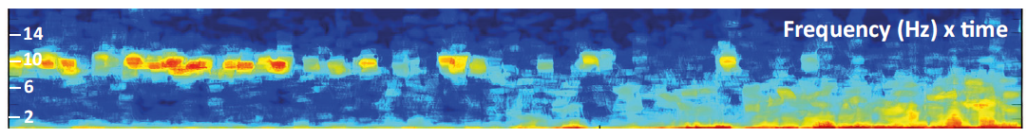
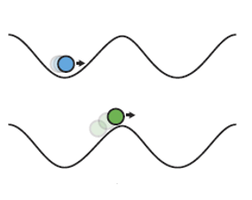

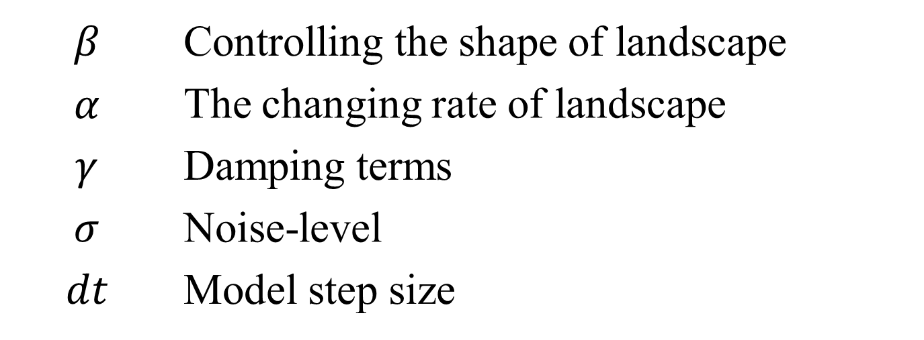
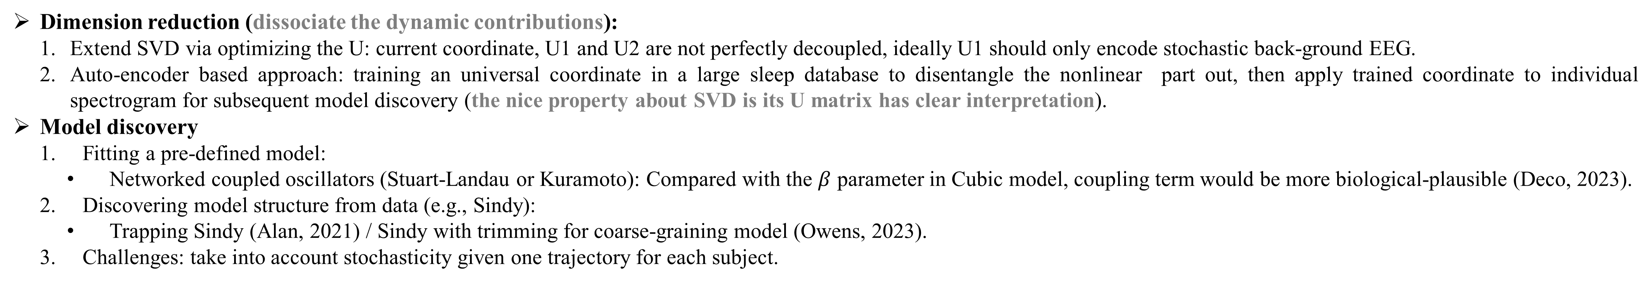
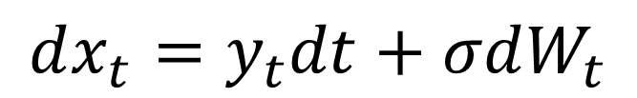
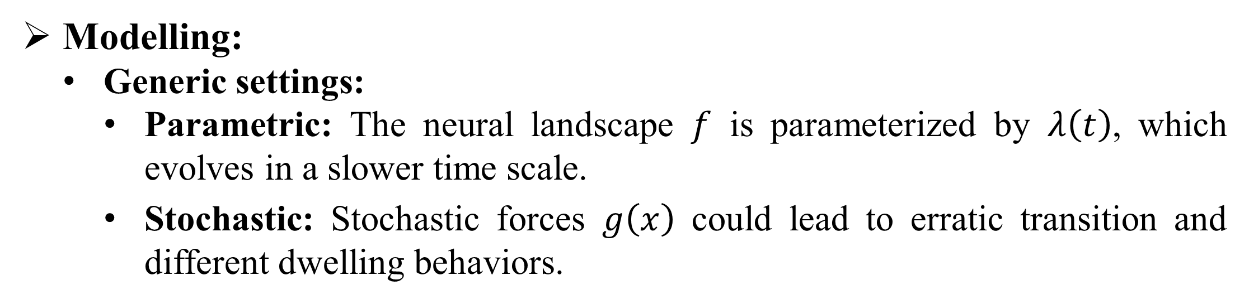
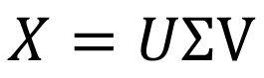
Learning interpretable dynamical models from wake-to-sleep EEG data
Zhenxing Hu¹, J. Nathan Kutz², Björn Rasch³, Jean-Julien Aucouturier¹
¹ Université de Franche-Comté, SUPMICROTECH, CNRS, institut FEMTO-ST, Besançon, France
² Department of Applied Mathematics, University of Washington, Seattle, Washington, United States
³ Division of Cognitive Psychology, Department of Psychology, University of Fribourg, Fribourg, Switzerland
Background
I. Dimension reduction
Phenomenon:
From wake-to-sleep, the EEG spectrum shows 1) 1st stage (wakeful state): progressive disappearance of the 10-Hz alpha rhythm, 2) transitional stage (metastable state): rapid transitions in metastable state with high individual differences, and 3) 4th stage (stable sleep state) gradual increasing of delta (0.5 – 4 Hz) activity dominating the power spectrum in the stable sleep state.
Goal
Find the intrinsic dimension, in which the dynamics could be sufficiently expressed by minimal number of states.
Find the optimal coordinate transform, in which the model has minimal number of terms and whose dynamics across different scales are decoupled.
(Lacaux, 2024)
$$X=UΣV$$
1st stage
2nd stage
3rd stage
4th stage
“Lullaby”
Wake
Metastable states
Sleep
“noise kick”
Falling asleep via
manipulating
neural landscape
“Alarm clock”
$$dx=f\left(x,λ(t)\right)dt+g\left(x\right)dW$$
Parameter-dependence
Parameter
Stochasticity
Modelling:
Generic settings:
Parametric: The neural landscape $f$ is parameterized by $λ\left(t\right)$, which evolves in a slower time scale.
Stochastic: Stochastic forces $g\left(x\right)$ could lead to erratic transition and different dwelling behaviors.
Spectrogram: From wake to sleep, spectrogram gradually shifts from alpha-dominant (8 – 12 Hz) to delta-dominant （0.5 – 3 Hz） state, while in the middle showing a transitional metastable regime.
Eigen time course / power spectrum: V2 capture most slow-scale dynamics, while V1 encodes more fast-scale dynamics and some stochastic process; U1 and U2 captures low-frequency background activity and alpha dynamics, respectively, but not perfectly decoupled.
Research question
Could different wake-to-sleep spectrograms be explained with an unified model structure but different parameterization? (scientific goal: understand the transitional mechanism from wake-to-sleep)
Low-dimensional trajectories
Roadmap
and
Two global attractors (wake and sleep) are shown in 3D space with different transitional dynamics across subjects in the middle.
Dynamics: V2 and V1 jointly explain the rapid transient dynamics, while the slow-scale dynamics (wake-to-sleep) is dominated by V2 mode.
Stochasticity: Noise is state-dependent, with different coupling strength (anisotropic) in current coordinate system.
II. Model discovery
and
$$β$$ | Controlling the shape of landscape
$$α$$ | The changing rate of landscape
$$γ$$ | Damping terms
$$σ$$ | Noise-level
$$dt$$ | Model step size
Parametric Cubic model
$β^{∗}=$1 | $α$ = -0.08 | $γ$ = -1 | dt = 0.3 | Initial condition = [-1;0], $β\left(0\right)=−1$ | $$σ=0.08$$
$$dβ=α\left(β−β^{∗}\right)dt, α<0$$
$$dx_{t}=y_{t}dt+σdW_{t}$$
$$dy_{t}=−\left(x_{t}+1\right)\left(x_{t}−β\right)\left(x_{t}−1\right)dt+γy_{t}dt++σdW_{t}$$
Summary
Given the same model step size, noise perturbation will speed up the process of falling into attractor [-1,0].
Only two states could be simulated by parametric Cubic model, hence the model doesn’t mimic transitional dynamics.
$dx=f(x,β)dt+σdW$ with $β$ moving from -0.75 to 0.75
Future steps
and
Dimension reduction (dissociate the dynamic contributions):
Extend SVD via optimizing the U: current coordinate, U1 and U2 are not perfectly decoupled, ideally U1 should only encode stochastic back-ground EEG.
Auto-encoder based approach: training an universal coordinate in a large sleep database to disentangle the nonlinear part out, then apply trained coordinate to individual spectrogram for subsequent model discovery (the nice property about SVD is its U matrix has clear interpretation).
Model discovery
Fitting a pre-defined model:
Networked coupled oscillators (Stuart-Landau or Kuramoto): Compared with the $β$ parameter in Cubic model, coupling term would be more biological-plausible (Deco, 2023).
Discovering model structure from data (e.g., Sindy):
Trapping Sindy (Alan, 2021) / Sindy with trimming for coarse-graining model (Owens, 2023).
Challenges: take into account stochasticity given one trajectory for each subject.

